Slide 1
GRASP: Designing Objects With Responsibilities
Chapter 17
Applying UML and Patterns
-Craig Larman

Slide 2
Designing Objects With Responsibilities
“Identify requirements, create a domain model and define dynamic behavior , define messages to meet requirements , add methods to the software classes …”
Too Simple!
  How do we assign responsibilities to classes?
  What methods belong where?

Slide 3
Object Design : Input
Use case text
  Defining the behavior
System sequence diagram
  Identifying the system operation messages
The operation contract
  Stating events to design for, and detailed post-condition to satisfy
Supplementary specification
  Defines non-functional goals
Glossary
  Data format, data related with UI and database
Domain model
  initial attempt of software object in the domain layer of software architecture

Slide 4
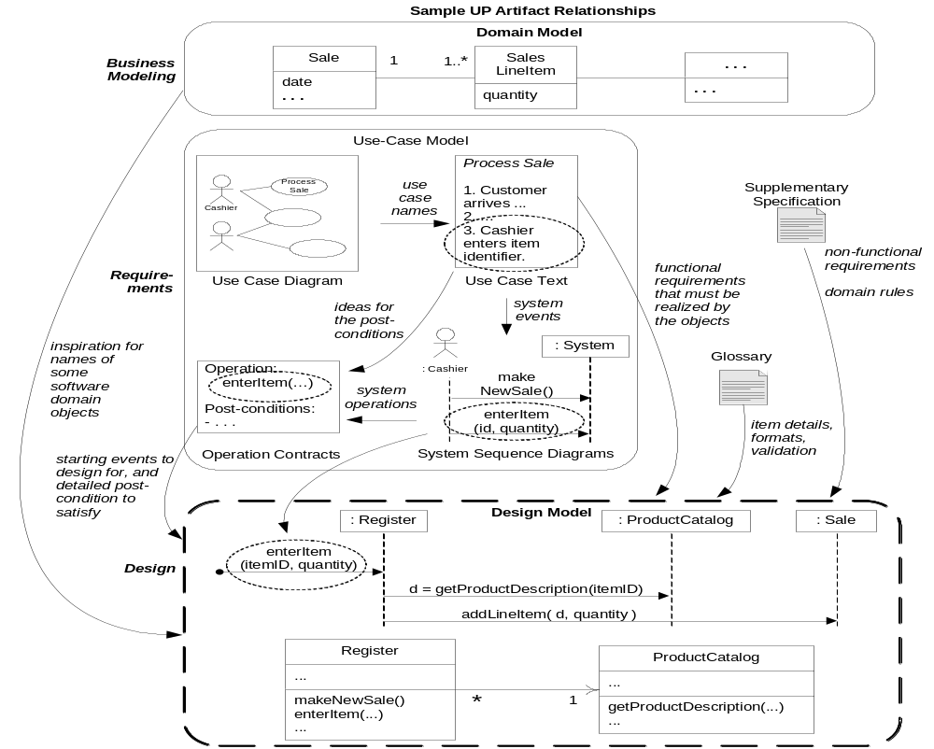
Fig. 17.1 UP artifacts influencing OO design

Slide 5
Responsability Driven Design-RDD
Design of behavior implies assigning responsibilities to software classes.
Responsibilities are assigned to classes of objects during object design.
Responsibility is a contract or obligation of a class
  What must a class “know”? [knowing responsibility]
  What must a class “do”? [doing responsibility]

Slide 6
Doing Responsability
What must a class “do”? [doing responsibility]
  Take action (create an object, do a calculation)
  Initiate action in other objects
  Control/coordinate actions in other objects
Doing responsibilities are implemented by means of methods
Methods fulfill responsibilities alone or through collaboration with other objects and methods.
  Ex: A Sale is responsible for creating SalesLineItems” (doing)

Slide 7
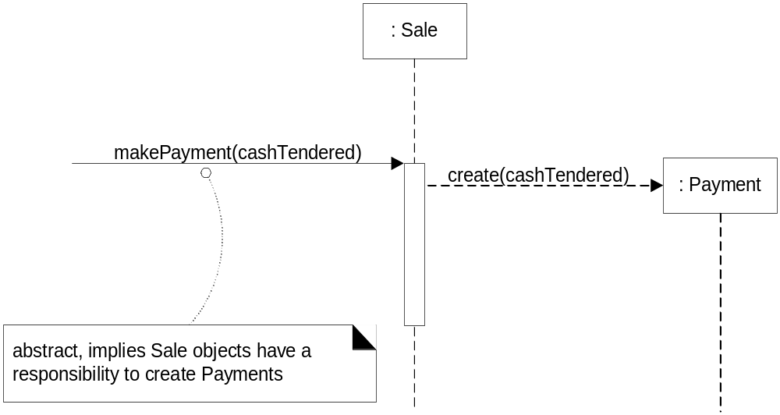
Responsibilities and methods : create
Sale objects are given a responsibility to create Payments.
The responsibility is invoked with a makePayment message

Slide 8
knowing responsibility
What must a class “know”? [knowing responsibility]
  Private encapsulated data
  Related objects
  Knowing about Things it can derive or calculate
Knowing responsibilities are related to attributes, associations in the domain model.
Domain model illustrates attributes and associations => inspires the “knowing” responsibilities.
  Ex : a Sale is responsible for knowing its total” (knowing)

Slide 9
RDD and Collaboration
Responsibilities are implemented by methods
Some methods act alone and do a task
Some collaborate with other objects to fulfill their responsibility.
    Example:
    Sale class has getTotal() method, the getTotal() collaborates with SalesLineItem objects to get the subtotal through getSubtotal() methods

Slide 10
Software pattern
What is a software pattern?
  A design pattern is a general reusable and
  proven solution to a commonly occurring
  problem in software design.
Craig Larman: “ a pattern is a named
problem/solution pair that can be applied in
new contexts, with advice on how to apply it in
novel situations”

Slide 11
Well‐known Pattern Families
GRASP = General Responsibility Assignment Software Patterns
    Describe fundamental principles for assigning
    responsibilities to classes and for designing
    interactions between classes
GoF: Gang of Four Design Patterns : 23 pattrens
We’ll cover with GRASP

Slide 12
GRASP Patterns
9 GRASP patterns , but we start with the first five
  Information Expert
  Creator
  Controller
  Low Coupling
  High Cohesion
  Polymorphism
  Pure Fabrication.
  Indirection.
  protected variation

Slide 13
Creator

Slide 14
Creator principle
  Problem: Who creates an A object
  Solution: Assign class B the responsibility to create an instance of class A if one of these is true
        B “contains or aggregate ” A
        B “records” A
        B “closely uses” A
        B “ has the Initializing data for ” A

Slide 15
Creator principle
  B “has the Initializing data for ” A that will be passed to A when it is created.
  Often initiation is done using a constructor with parameters.
  e.g. a Payment instance, when created
  needs to be initialized with the Sale total.
  Sale class knows Sale total. Good candidate for creating Payment is Sale.
If more than one of the above applies, prefer a class B which aggregates or contains A.

Slide 16
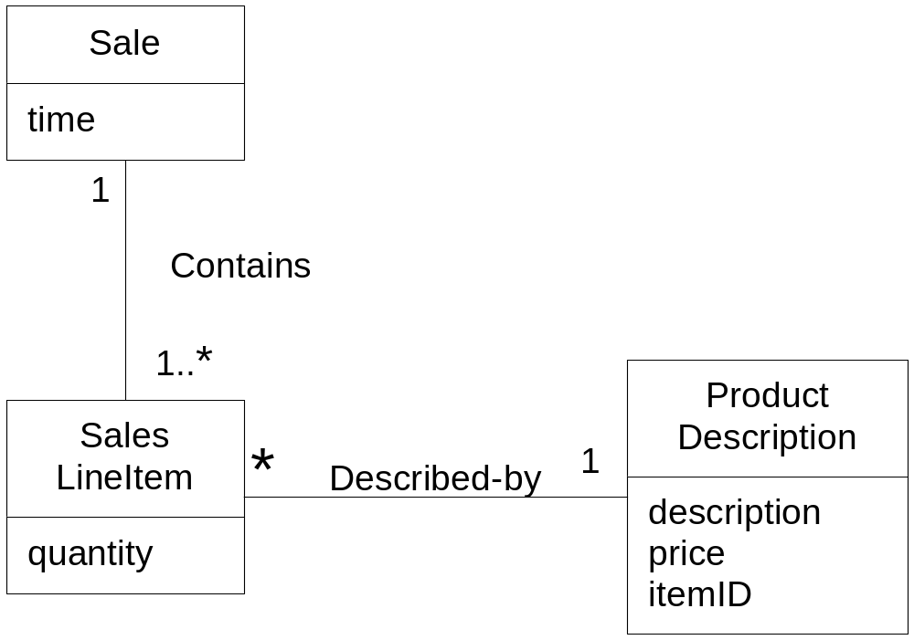
Problem
Who should create a SalesLineItem?

Slide 17
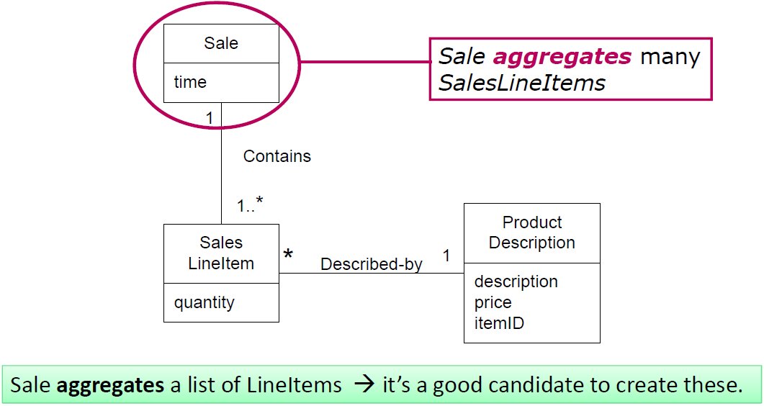

Slide 18
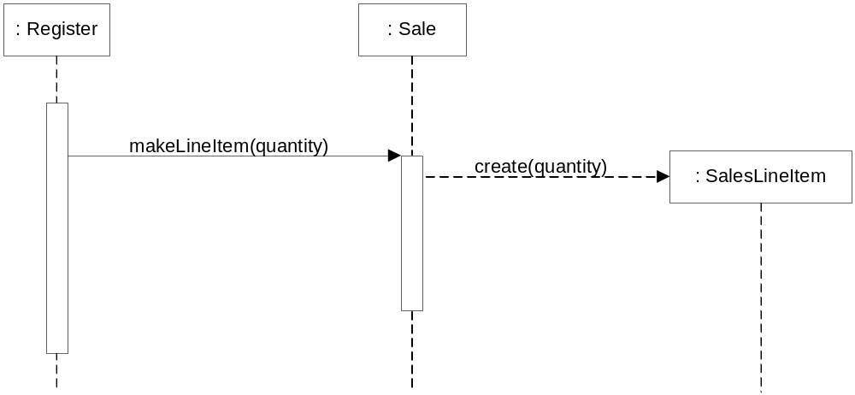
Creating a SalesLineItem
Sale objects are given a responsibility to create SaleLineItem.
The responsibility is invoked with a makeLineItem message

Slide 19
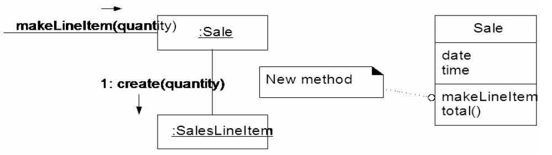
Creating a SalesLineItem

Slide 20
Contraindications
Creation requires complexity
  Recycled instance for performance
  Creating an instance from one of a family of similar classes based on external property etc.
      Helper class (abstract or concrete façade)

Slide 21
Benefits
Lower maintenance due to low coupling
Higher opportunities for reuse.

Slide 22
Information Expert

Slide 23
Information Expert
Problem : What is a general principle of assigning responsibilities to objects?
Solution (advice ) : Assign a responsibility to the information expert , that is the class with the information necessary to fulfill the responsibility.
“Objects do things related to the information they have.”

Slide 24
Applying Expert in POS Application
Start assigning responsibilities by clearly stating the responsibility.
  Who should be responsible for knowing the grand total of a sale?

Slide 25
  Who should be responsible for knowing/getting the grand total of a sale?

Slide 26
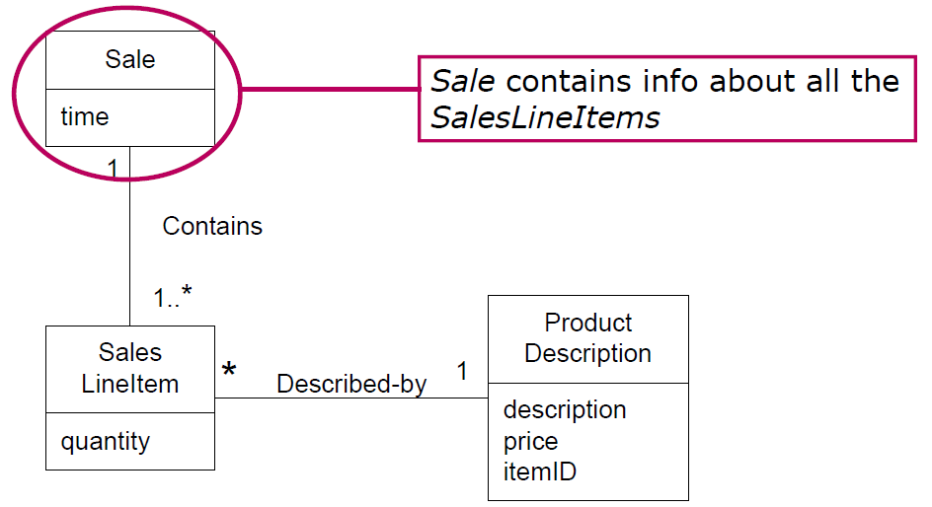

  Who responsible for knowing the grand total of a sale?

Slide 27
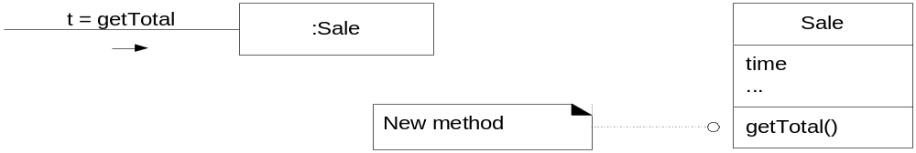
Partial interaction and class diagrams
Add a Sale class to the Design Model.
Express responsibility of knowing the total of a sale with the method named getTotal.
  What information do we need to know to determine the line item subtotal?
  Sale knows about neighbours (associations), SaleLineitems who is responsible for knowing its subtotal

Slide 28
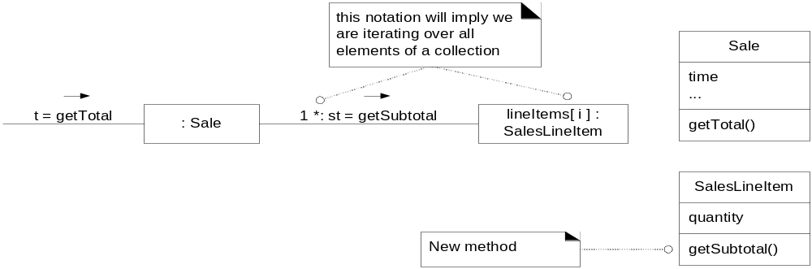
SalesLineItem is Expert for Subtotal
  How does the SalesLineItem find out the product price?
  SaleLineItem knows about neighbours ( ProductDescription) to get the price.

Slide 29
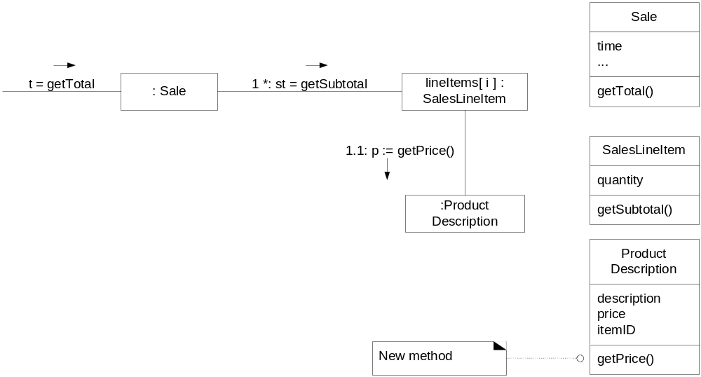
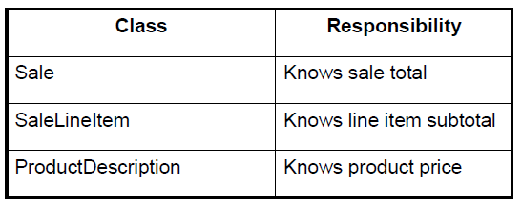
ProductDescription is Expert for Price
“Partial” information experts collaborate to fulfill the responsibility.

Slide 30
contraindication
Solution of expert is not desirable in some cases due to problems of coupling and cohesion
To overcome this in one place(like domain object)
Keep db object in other place.

Slide 31
Benefits
High cohesion is supported
Information encapsulation use their information to fulfill the tasks.

Slide 32
Low Coupling Principle

Slide 33

“Low Coupling” Principle
Problem:
  How to support low dependency, Low change impact, and increased reuse?
Solution: Assign responsibilities so that coupling remains low. Use this principle to evaluate alternatives.
Coupling is a measure of how strongly one class is connected to, has knowledge of, or relies upon other classes.

Slide 34
What is a coupling ?
Coupling between classes is dependency of one class on another class
Common form of coupling from Class A to Class B are:
  Class A has an attribute (data member or instance variable) that refers to a Class B instance, or Class B itself.

Slide 35
What is a coupling ?
Common form of coupling from Class A to Class B are:
  Class A has a method which references an instance of Class B, or Class B itself, by any means. These typically include a parameter or local variable of type Class B, or the object returned from a message being an instance of Class B.

Slide 36
What is a coupling (continued) ?
Common form of coupling from Class A to Class B are:
  Class A is a direct or indirect subclass of Class B.
  Class B is an interface, and Class A implements that interface.

Slide 37
Common Forms of Coupling in OO Languages
Type X has an attribute (data member, instance variable) that refers to type Y or an instance of Y.
An object of type X calls on services of a type Y object.
Type X has a method that references an instance of type Y (e.g., parameter, local variable, object returned from a method).
Type X is a subclass of type Y.
Type X implements the interface Y.

Slide 38
Low Coupling - POS Case Study
What class should be responsible for creating a Payment instance and associating it with the Sale?
  Register?
  Sale?
Creator pattern suggests Register should create the Payment.
  A register records a payment in the real world.

Slide 39
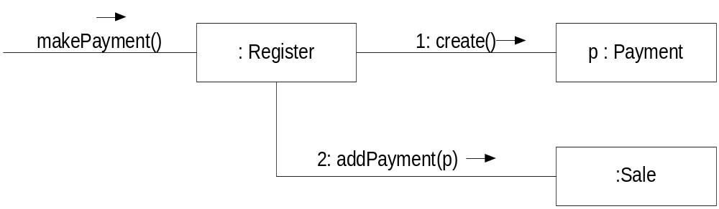
What if Register creates Payment
Register is coupled to both Sale and Payment.

Slide 40
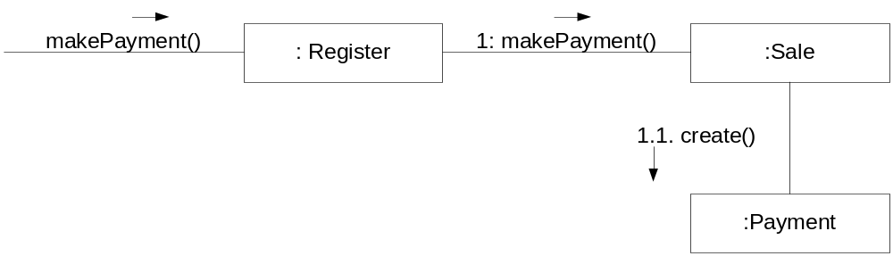
What if Sale creates Payment ?
Assuming that the Sale must eventually be coupled to knowledge of a Payment, having Sale create the Payment does not increase coupling.
NB : Low Coupling and Creator may suggest different solutions.

Slide 41
Benefits
Not affected by changes in other components
Simple to understand in isolation
Convenient to reuse

Slide 42
Controller Pattern

Slide 43
Controller Pattern
UI layer does not contain any business logic
Problem:
How to connect UI layer to the business logic layer?
Solution:
If a program receive events from external sources
other than its graphical interface, add an event class
to decouple the event source(s) from the objects
that actually handle the events.

Slide 44
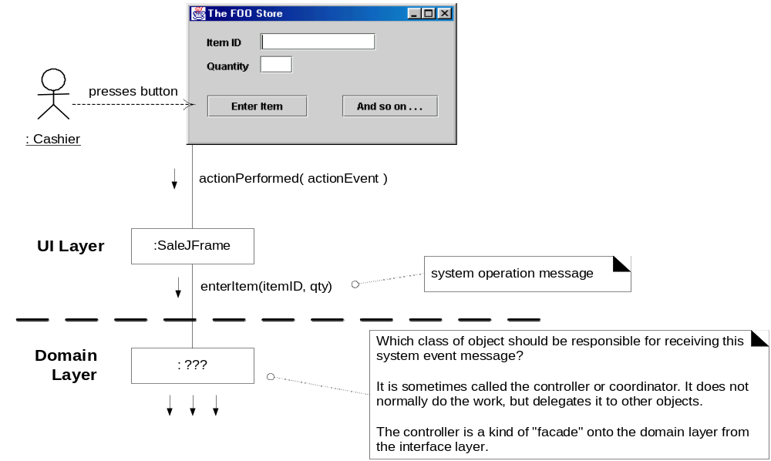
What should be Controller for enterItem?

Slide 45
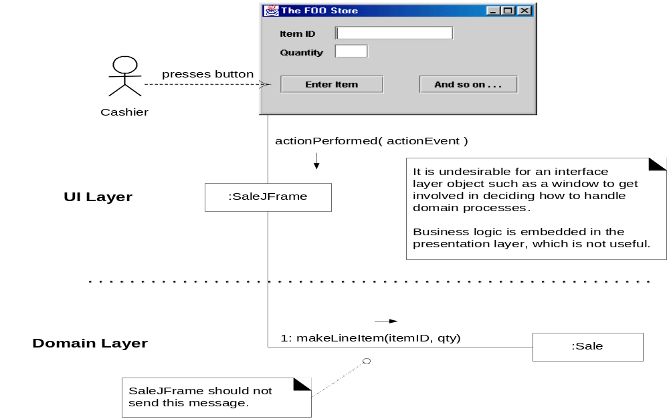
Bad Design

Slide 46
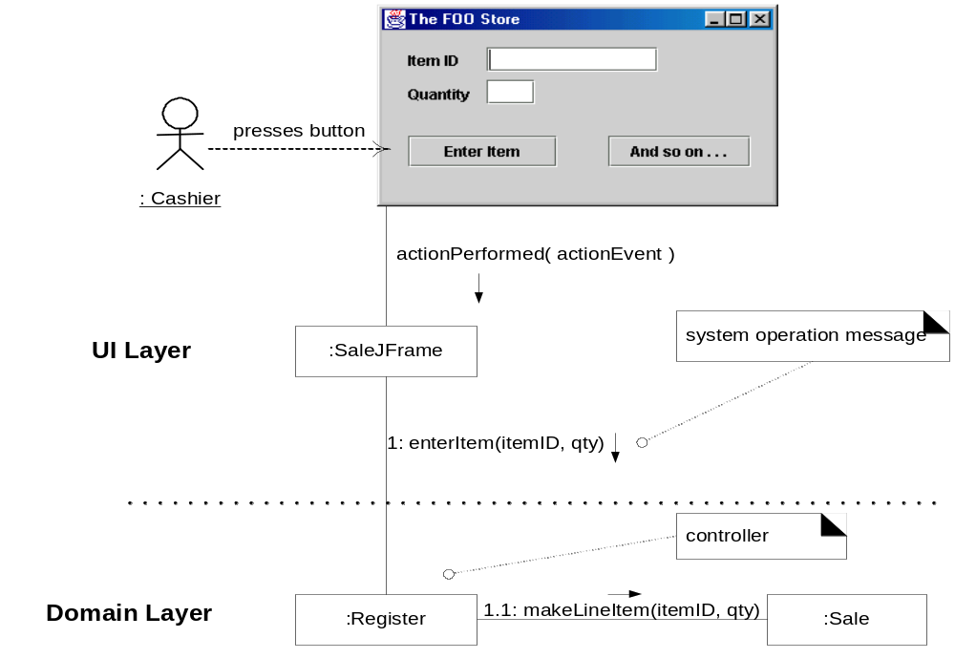
Good Design
Controller should delegate the work that needs to be done to other objects.

Slide 47
Controller: Benefits
Increased potential for reuse
  Ensures that the application logic is not handled in the interface layer. Thus, the external event raisers are independent of internal event handlers
Plug & Play interfaces
  Since the interface is not bound to the controllers, it can be replaced or updated without much impact
Verifying the reasoning of the use case
  Allows us to verify that the system operations occur in a logical sequence. For example: makePayment() is not called before endSale()

Slide 48
High Cohesion

Slide 49
High Cohesion
Cohesion is a measure of how strongly related the responsibilities of an element (classes, subsystems) are.

Slide 50
High Cohesion
Problem
  How to keep complexity manageable?
Solution
  Assign a responsibility so that cohesion remains high

Slide 51
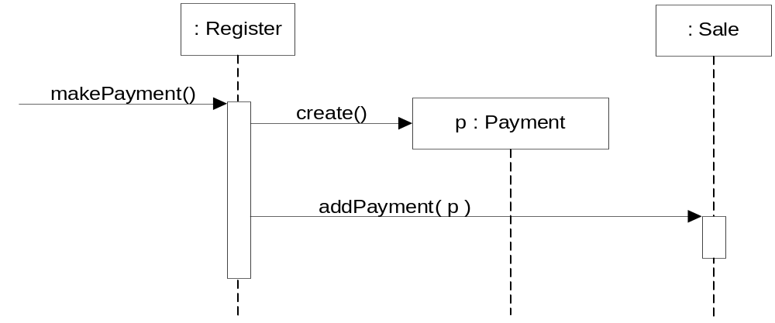
Reduced cohesion of Register(creator pattern)
Low cohesion:
Register is taking part of the responsibility for fulfilling “makePayment” operation and many other unrelated responsibility ( 50 system operations all received by Register).then it will become burden with tasks and become incohesive

Slide 52
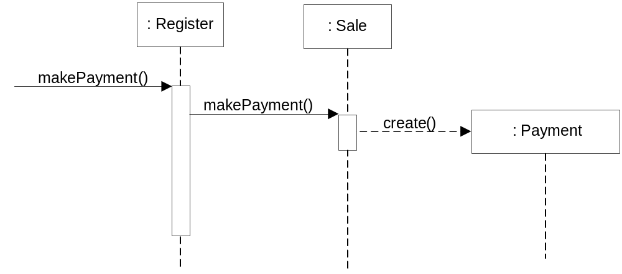
Better solution
Higher Cohesion and Lower Coupling
Solution:
Delegate the payment creation responsibility to “Sale” to support high cohesion

Slide 53
Benefits
Clarity and ease of comprehension of the design is increased
Maintenance and enhancements are simplified
Low coupling is often supported
Reuse of fine grained,related functionality is increased because a cohesive class used for specific purpose.

Slide 54
Polymorphism
Problem : How to handle alternatives based on type?
Solution:
  Assign responsibilities using polymorphic operations.

Slide 55
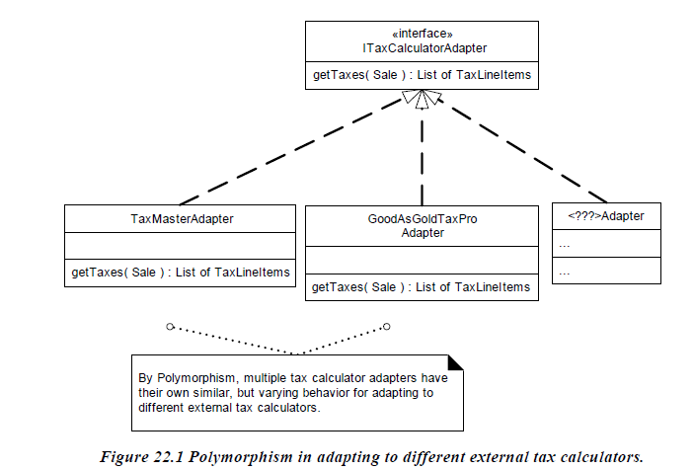

Slide 56
By polymorphism ,multiple tax calculator adapters have their own similar but varying behavior for adapting to different external tax calculator

Slide 57
Contradiction
  Future proofing
  Benefits
  Extensions required for few new variations can be added .

Slide 58
Indirection
Problem: where to assign a responsibility to avoid coupling between two or more things?
How to decouple objects so that low coupling is supported and reuse potential remains high?

Slide 59
Soln:
Assign the responsibility to an intermediate object to mediate between other components on services so that they are not directly copupled.
This intermediate creates an indirection between the other objects.

Slide 60
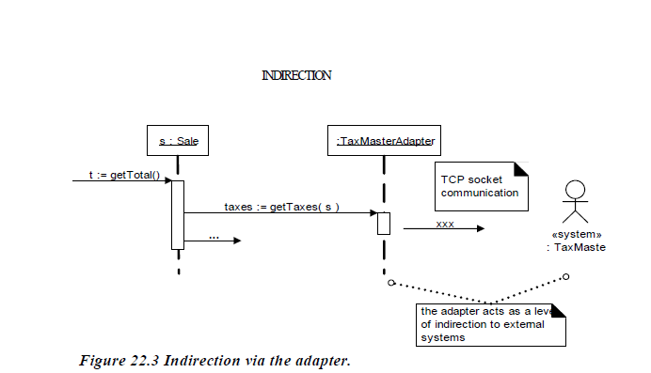

Slide 61
Benefits:Low coupling between objects

Slide 62
Protected variation
Problem :How to design objects subsystems and systems so that variations in these elements does not have an undesirable impact on other elements.

Slide 63
Soln: Identify points of predicted variation or instability.
Assign responsibilities to create a stable interface around them.

Slide 64
Contradiction:
  IT checks for the existing
  Does not consider future variations.

Slide 65
Pure fabrication
  What object should have the responsibility ,when do you want to violate high cohesion and low coupling or other goals, but solns offered by expert are not appropriate?
  Soln: assign high cohesive set of responsibilities to an convenience class that does not represent a problem domain concept.

Slide 66
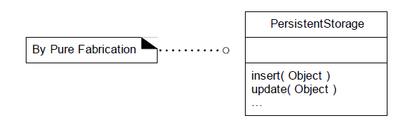

Slide 67
Benefits:high cohesion is supported
Reuse potential may increase
Contridiction:overuse

